Slide 1
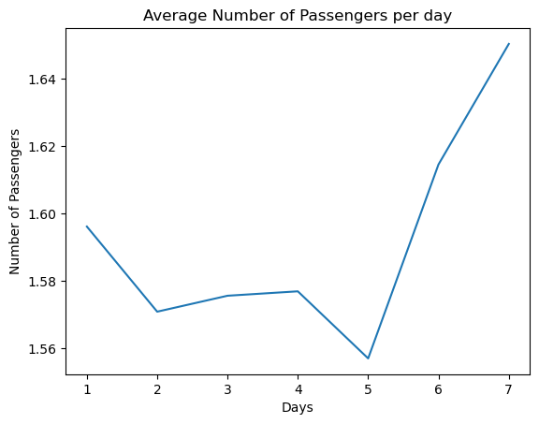
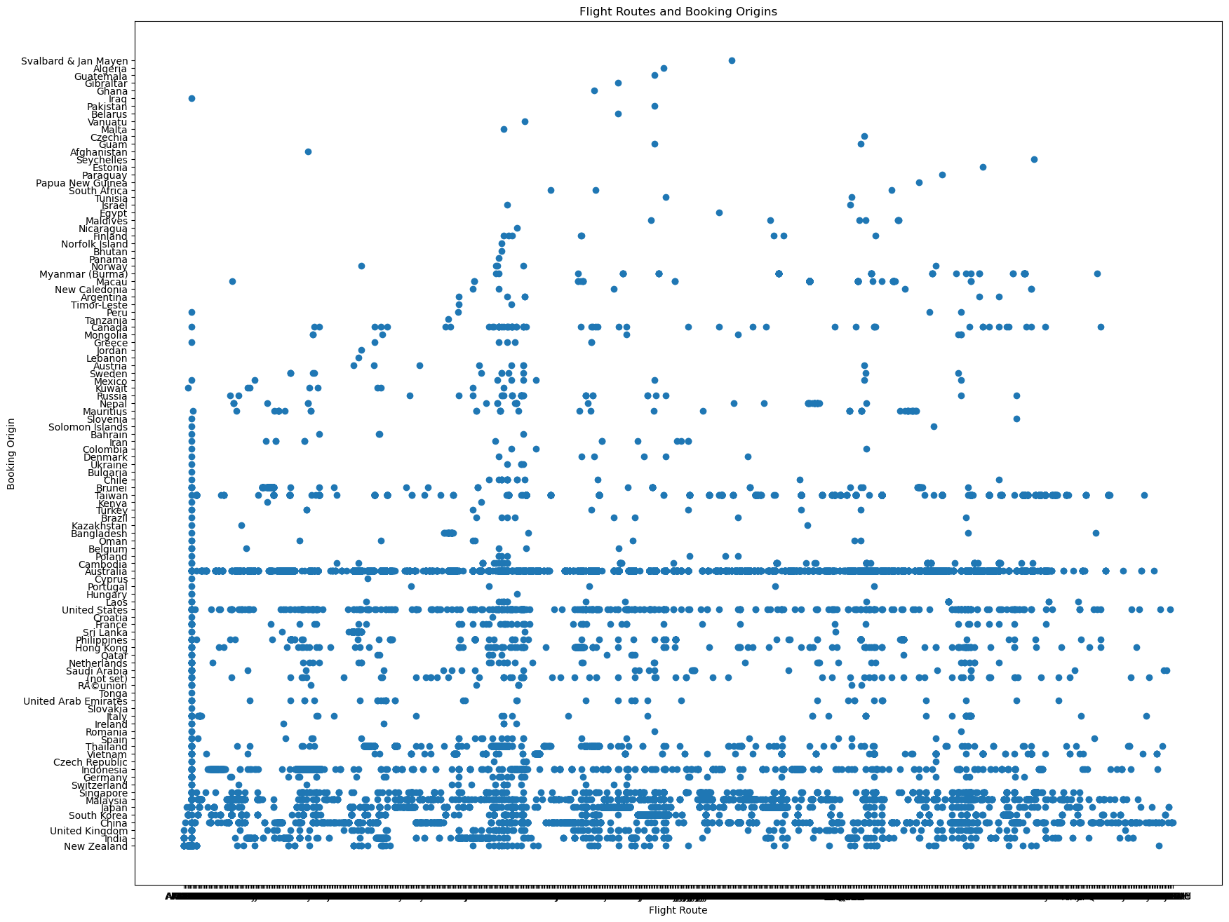
British Airways Visualizations
BA needs to visualize the flight routes and booking origins to be informed of what country has the most travel
BA needs to know how many passengers fly out of the country and what day is more profitable using a line chart.

Slide 2
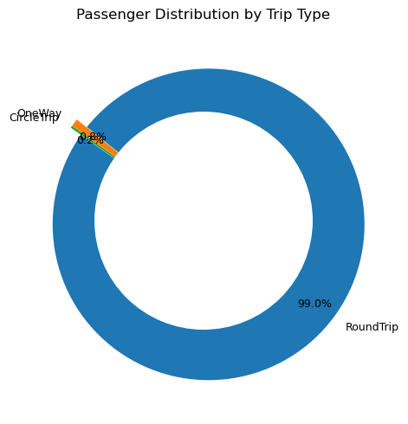
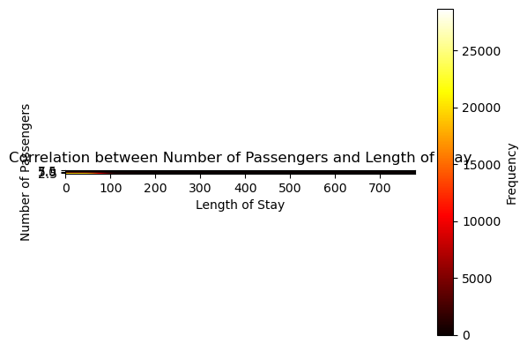
British Airways could maximize on the fact that people tend to travel roundtrips to visit
Heat Map illustrates how long people stay at a vacation spot.

